Slide 1
Breaking LTE on Layer 2
IEEE S&P’19 – David Rupprecht, Katharina Kohls, Thorsten Holz, Christina Pöpper
Presenter: David Ha

Slide 2
Introduction
Problem: Existing work focus on layer 1 and 3 of the LTE stack protocol
Goal: Perform analysis and vulnerability exploitation in layer 2
Contributions
LTE Layer 2 analysis: control plane leakage and user plane missing integrity
3 attacks: 2 passive attacks and 1 active attack
Notes:
The current problem with the LTE stack protocol is that research are focused on the physical layer (layer 1) and the networking layer (layer 3)
This paper aims to analyze layer 2 to find vulnerability and exploit them.
So the authors did that and analyzed the layer 2 and found out that the control plane is possibly leaking information and that the user plane doesn’t have integrity check
Using those vulnerabilities, they performed 3 attacks 2 of them are passive and the last one is active
Before getting into the details of the attacks, I will give you a brief introduction of the LTE protocol for you to understand how the authors exploited its flaws to perform their attacks.

Slide 3
LTE
User C
User A
Switching node
Switching node
User D
User B
Packet-switching only LTE
Notes:
LTE is based purely on packet-switching. In such an architecture, sender divides any sort of data – email, web pages, Netflix stream – into small packets of equal size, each of which carries an “address label” bearing its final destination. The sender proceeds to send them over the network where they are directed toward their destination at every juncture or “node”. They eventually all meet up at their destination where they are reassembled and delivered to the recipient. This is more cost-effective in networking terms as you share everything in the same channel.
So, what are the components that allow such a network infrastructure to run?

Slide 4
LTE components
User Equipment (UE)
End device providing services to the user
IMSI, RNTI
Evolved Node B (eNodeB)
Base stations
Radio resource management, user data encryption, paging messages, etc
Evolved Packet Core (EPC)
Core Network
Authentication, mobility management, forwarding of user data
Notes:
We will be focusing on 3 components which will be exploited in this paper
First, we have the User Equipement which is basically the end device providing services to the user
Then we have the eNodeB which acts like a base station and performs radio resource management, user data encryption, paging messages and so on
And finally we have Evolved Packet Core which is the core of the network and is responsible for authentication, mobility management and forwarding of user data
LTE stack protocol is divided into 3 layers to make those components run

Slide 5
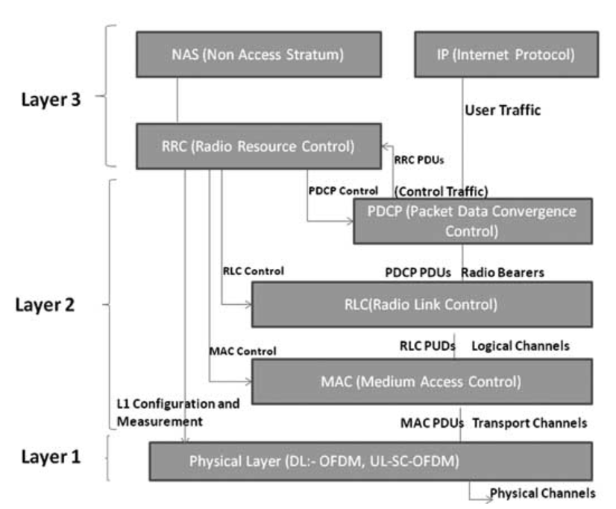
LTE Protocol Stack layers
Layer 1: carries all information over the air interface
Layer 2: extends the physical layer and provides mechanisms for reliability, security and integrity
Layer 3: interconnection of nodes within a network allowing UE mobility
Notes:
First, you have first layer which is the physical layer which carries all information over the air interface.
Then, you have the second layer which is the data link layer. It will extends the physical layer and provides mechanisms for reliability, security and integrity
Finally you have the third layer, which will handle interconnection of nodes within the network allowing UE mobility

Slide 6
Previous work
Layer 1: jamming attacks denying access to the network
M. Lichtman and al., “Vulnerability of LTE to hostile interference”
M. Lichtman and al., “LTE/LTE-A Jamming, Spoofing, and Sniffing: Threat Assessment and Mitigation”
F. M. Aziz and al., “Resilience of LTE ¨ Networks Against Smart Jamming Attacks: Wideband Mode”
R. P. Jover, “Security Attacks Against the Availability of LTE Mobility Networks: Overview and Research Directions”
Signal
Notes:
So, previous work focused on Layer 1 and Layer 3 of the LTE stack protocol.
On the physical layer, jamming attacks were successful
Jammers are devices that blocks or interferes with authorized communications. Basically, it will transmit on the same radio frequencies as the cell phone, disrupting the communication between the phone and the base station. The jammer denies service to the cellphone user within its range.

Slide 7
Previous work
Layer 3: attackers can localize an user or deny access to the network
A. Shaik and al., “Practical Attacks Against Privacy and Availability in 4G/LTE Mobile Communication Systems”
R. P. Jover, “LTE Security, Protocol Exploits and Location Tracking Experimentation with Low-Cost Software Radio”
S. F. Mjølsnes and R. F. Olimid, “Easy 4G/LTE IMSI Catchers for Non Programmers”
Localization attack
C-RNTI: physical layer identifier not encrypted
Mapping TMSI or MSISDN to C-RNTI
DoS attack
Rogue eNodeB
Downgrade UE to GSM
What about Layer 2?
Notes:
On the network layer, previous work proved that an attacker could locate a user or deny access to the network
Localization used the C-RNTI identifier to follow the user. C-RNTI is a physical layer identifier unique per device within a given cell. As the C-RNTI is included in the header of every single packet. As physical layer doesn’t provide any encryption. Then they would just map the TMSI or the phone number to the C-RNTI.
As for denial of access attack, 2 of them used a rogue eNodeB or they would downgrade the UE to GSM which is known to be also vulnerable
(figure) But what about layer 2?
Let me give you a brief overview of the layer 2 for you to understand how they took advantage of it to perform their attacks

Slide 8
Layer 2 overview
PDCP
Encryption and integrity for messages to upper layers (IP and RRC)
Transmission modes: AM, UM and TM
Error correction, segmentation, assembling data
Retransmission handling
RLC
Managing access to radio resources: RNTI
UE performs RAP (Random Access Preamble)
eNodeB gives RAR (Random Access Response)
MAC
Notes:
From bottom to top, you first have the MAC layer or Medium Accesss Control: it manages the access to the radio ressources of LTE network
Basically, your phone needs to be distinguishable with a unique identity within a cell, the RNTI like mentionned previously. To obtain this identifier, the UE performs Random Access Preamble with the eNodeB of its current cell then the eNodeB will answer with a Random Access Response. During this exchange process, the MAC layer determines the radio resources available for the UE and matches them to the RNTI and signals this to the UE which will use it for future transmissions.
Then, you have the RLC Layer: it offers 3 transmission modes, Acknowledged Mode, Unacknowledged Mode and Transparent Mode. The mode determines how the content goes through this Layer from lower layer to upper layer. Depending on the chosen mode, RLC protocol applies error correction, segmentation and assembles data into the correct order for the upper layer. IT also manages packet retransmissions.
Finally, the PDCP protocol provides encryption and integrity protection for messages to the upper layers (IP and RRC). IP is for data plane messages and RRC for control plane messages.

Slide 9
Attacking layer 2

Slide 10
Types of attacks
2 passive attacks
Identity mapping attack
Website Fingerprinting
Active attack: aLTEr
DNS Spoofing attack
Man-in-the-middle to intercept communications
Redirects to a malicious website
Notes:
Several vulnerabilities arise from the Layer 2
Out of 3 attacks, identity mapping and website fingerprinting are passive attacks in which the attacker will eavesdrop transmissions between user and base station
However, the third and last attack is a dns spoofing attack named aLTEr which allows an attacker to perform man-in-the-middle attacks to intercept communications and redirect victim to a malicious website using DNS spoofing attack.
Let’s see what identity mapping attack is about

Slide 11
Identity mapping attack
What is the goal?
Infer the identity of a user by eavesdropping the radio connection establishment (MAC sublayer)
Attacker
Ignores the TMSI¹ and RNTI² of the victim
Learns the identity during the radio layer connection establishment
¹ TMSI: Temporary Mobile Subscriber Identity
² RNTI: Radio Network Temporary Identifier
Notes:
This attack aims to identify more or less a user by eavesdropping the connection establishment procedure between the UE and eNodeB.
The attacker ignores the TMSI and RNTI of the victim and learns the identity of the victim during the radio layer connection establishment.

Slide 12
Connection establishment process
Notes:
In the connection process, the UE will first send a (1) Random Access Preamble and then receives the (2) response (Random Access Response)
This response includes the C-RNTI which serves as a unique identifier of the user within the cell he uses until the connection is released. The UE sends an RRC connection request to the eNodeB which include the UE’s identity meaning the TMSI or a random value if the UE doesn’t possess a valid TMSI.
Finally, the eNodeB will reply with a connection setup message.
The attack will eavesdrop using the sniffers in uplink direction or downlink direction.
Uplink transmission means from the UE to the eNodeB and downlink transmission is from eNodeB to the UE.

Slide 13
The attack
UE is identified by C-RNTI on the MAC layer
Only 10 possible RA-RNTIs
RA-RNTI = 1 + t_id (0 <= t_id <= 9), t_id is the index of the first subframe of the physical channel
Possible to monitor all RAR and infer the C-RNTI
Matching C-RNTI and TMSI with 2 methods:
The uplink sniffer
Exploiting the contention-based resolution of the RRC connection setup
Notes:
When the UE receives its C-RNTI from the RAR message, it will use it for identification on the MAC layer for each following transmissions. To deduce the C-RNTI of the UE, we will use the RA-RNTI. You have at most 10 possible RA-RNTI values given by the following equation : 1 + t_id where t_id is the index of the first subframe of the physical channel used and can range from 0,9 therefore RA-RNTI can range from 1,10. So, i’ts possible to monitor all RAR messages coming from eNodeB as each one of them will use RA-RNTI to send a C-RNTI.
After getting the C-RNTI, we can match it to a TMSI using either the uplink sniffer or exploiting the contention-based resolution of the RRC connection setup.

Slide 14
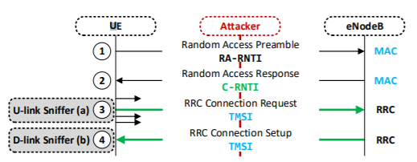
Uplink sniffer
UE sends RRC connection request (with TMSI)
C-RNTI used to filter out this specific request
Find uplink transmission with the corresponding C-RNTI
Match the C-RNTI and the TMSI
Notes:
As you can see, when the UE sends a RRC connection request, it also attaches its TMSI. All the attacker has to do is to filter all the transmission containing the monitored C-RNTI going to the eNodeB and find the specific RRC connection request. Therefore they can match the C-RNTI and TMSI.

Slide 15
Downlink sniffer
In (1), it’s possible that multiple UEs send the same RAP
In case of contention resolution, (4) has to include previous uplink data unit
Previous uplink = RRC Connection Request
Match the C-RNTI from (2) and the TMSI from (4)
Notes:
It’s not unusual that in step 1, multiple devices send the same Random access preamble, this is called contention. In this case, the eNodeB will perform contention resolution so each device has a unique identifier.
In this process, when the eNodeB answers to the RRC connection request from the UE, it will also attach the previous uplink data unit and in this case this is the RRC connection request which includes the TMSI of the target UE
They finally only have to match the C-RNTI from step 2 to the TMSI that they got from step 4.

Slide 16
Experiment
Two Software Defined Radios (SDRs)
The UE
The Downlink sniffer
Target UE
Implements srsUE (all layers)
Can connect to a commercial network
Downlink sniffer
Implements srsLTE
Listens to broadcast channels of eNodeB
All traces at the UL and DL sniffers are recorded to evaluate the attack
Notes:
They performed the Downlink sniffer attack with 2 SDR, software defined radios which are radios in which all of the physical layer functions are software defined.
One will be representing the UE and the other one the downlink sniffer
The UE implements srsUE which is modified to be able to connect to a commercial network.
The second SDR represents the downlink sniffer which also implements srsLTE and will listen to the broadcast channels of eNodeB.
All traces from uplink and downlink sniffers are recorded to evaluate the attack

Slide 17
Experiment: Attack steps
TCP connection to trigger radio connection establishment process
Downlink sniffer eavesdrops RARs of eNodeB and get all C-RNTIs
eNodeB sends TMSI in RRC connection setup within the contention-based resolution which is eavesdropped by DL sniffer
Match the set of C-RNTIs with the eavesdropped TMSI from 3.
Notes:
First step is to setup a new TCP connection to an arbitrary server to trigger the radio connection establishment process
Then the downlink sniffer will eavesdrop the RARs from eNodeB to get the C-RNTI
Following the RRC connection request from the UE, eNodeB sends TMSI in RRC connection setup within the contention resolution which is also eavesdropped by the downlink sniffer
Finally, all they have to do is match the set of C-RNTI with the eavesdropped TMSI from 3.

Slide 18
Identity Mapping Results
Attack successfully performed 3 times with downlink sniffer
TMSI and C-RNTI mapping information from arbitrary UE but no a specific UE
96 911 connection establishment procedures recorded in 5 days
96.85% contained contention-based resolution
91.75% contain TMSI
Real-world applicability?
Notes:
The authors successfully performed the identity mapping attack 3 times with the downlink sniffer.
You need to remember that they match all the TMSIs to their set of C-RNTIs so this is not matching a specific UE to a TMSI
They recorded a total of 96,911 connection establishment procedures within the cell of a commercial network. 96.85% of those radio connection procedures contained a contention-based resolution and 91.75% of which contain a valid TMSI.
But is this applicable in real-world environment? Personnally, I don’t think so.
Well, using the downlink sniffer has a constraint, you need a TMSI in the RRC connection setup. One case is like when you turn on your phone, you don’t have any temporary identifier.
Plus they can only match their set of C-RNTI to a TMSI, so they can match all the C-RNTI that they have to a TMSI but they can’t map it to a specific user.

Slide 19
Website fingerprinting attack
What is the goal?
Learning the destination of a connection
MAC layer schedules data transmission of a connection (DCI)
Data allocation for uplink and downlink for each user
Sends the data allocation to each UE in a DCI message
DCI information is not encrypted
Notes:
This attack is also pretty simple, the goal is to learn what the target is visiting.
The MAC layer is responsible for scheduling the data transmission of a connection for each user. It will determine the data allocation for each user and send the information to the UE in a DCI message.
What you need to remember is that DCI information is not encrypted.
So how do you know only from the metadata features containted in the DCI information what website someone is visiting?

Slide 20
How is it done?
binance.com
netflix.com
Notes:
Well say for example, if I visit binance which is a cryptocurrency exchange website, I will use less traffic compared to when I am watching a show on Netflix.
(animation) All the attacker has to do is eavesdropping on the DCI information
As the DCI information is not encrypted, it is easy to extract metadata features such as PDCP packet length from which we can deduce the data consumption per time unit for a specific user.

Slide 21
How is it done?
Attacker records a corpus of traces corresponding to a set of websites (before the attack)
Analyze the previous traces that were eavesdropped and compare them to the records
Try to match the metadata features to the recorded traces
Notes:
The attacker possesses traces for a set of websites that he recorded before the attack.
After getting the traces from the target, he compare them to the records and see if he can match the metadata features of the target to the recorded traces metadata features.

Slide 22
Experiment
LTE network setup
Modified version of srsLTE eNodeB
OpenAirInterface Evolved Packet Core (EPC)
Connect Commercial-of-the-shelf (COTS) phone to the LTE network
3 Android phones: LG Nexus 5, Huawei P9 Lite, Motorola Moto G4
pcap traces from visiting Alexa top 50 websites 100 times per phone
Extract only user plane traffic: RNTI, PDCP direction (up/down), PDCP sequence number, PDCP length and timestamp of each packet
Notes:
To carry their experiment, they implemented their own eNodeB and core network and connected commercial phones to the their LTE Network.
They tested using 3 android phones: LG Nexus 5, Huawei P9 Lite and Motorola Moto G4
They also captured pcap traces from visiting Alexa top 50 websites 100 times per phone (those are the traces that they will use to compare the eavesdropped traffic from the victim)
From those pcap traces, they will only extract user plane traffic including RNTI, PDCP direction (up or down), PDCP sequence number, PDCP length and timestamp of each packet.

Slide 23
Experiment
Classify unknown traces
Compare all captured traces using FastDTW for similarity measurement
Decision with k-NN
How do you know it is successful?
Average success and standard deviation
False positive matches for each site
Notes:
To fingerprint the traces, first, they will compare the captured traces using fast dynamic time warping, FastDTW to compute the similarity of measured traffic.
They will then decide with k-nearest neighbor algorithm which website the measured traffic correspond to.
So, how do you measure the success of this attack?
We get the average success (True positive rate) and standard deviation aswell as false positive rate

Slide 24
Website fingerprinting results
Figure: Attack success rates
Average success rate:
89.63% in downlink transmissions
89.13% in uplink transmissions
Notes:
The following table shows the results: the average success rate across all 3 devices is as follow
89.63% in downlink transmissions
89.13% in uplink transmissions
For each phone individually when comparing traces

Slide 25
Website fingerprinting results
Closed-world setup
Mobile networks configuration changes a lot
Impossible to monitor uplink transmissions on PDCP layer on real LTE network
Limited to Alexa Top 50 websites
~2 billions websites
Real-world applicability?
Notes:
This is a closed-world scenario where the LTE network is totally under their control because mobile networks configuration changes a lot, it is difficult to mimic it, and it’s impossible for them to monitor uplink transmissions on the PDCP layer on a real LTE network because of synchronization depending on the distance between the UE and eNodeB. Therefore, because of those 2 reasons they chose not to opt for the open-world setup.
Plus, they used only 50 websites to perform the comparison which is meaningless compared to the number of websites that are running which is close to 2 billions websites.
So is it usable in a real-world setup? Of course not, but this is a stepping stone for future work as it is just a proof-of-concept that this is possible.
Now that we have seen that those 2 passive attacks were kind of limited let’s move on to the last attack

Slide 26
aLTEr attack
Active attack
Send signals to both the network and the device
UE perceives the adversary as usual cellular network provider
Cellular network perceives the adversary as the UE
Source: https://alter-attack.net
Notes:
The last attack I am going to present is the aLTEr attack. This one is an active attack meaning that the attacker will send signal to both the network and the user’s device. In this case, the adversary will be perceived by the user as an usual cellular network provider and as an user to the cellular network.

Slide 27
What does it do?
PDCP
RLC
User data manipulation
Integrity issue in the data link layer
Alter packets going over the cellular network
Attack
Modify content of a packet if the original content is known
Manipulate destination IP address of a DNS request
Redirect requests to a malicious server
MAC
Notes:
In a nutshell, the attacker will exploit the fact that integrity protection is only applied at the PDCP layer and isn’t applied all the way down to the MAC layer.
So you can modify the content of a packet if you know its original content.
One of the most interesting one is DNS packet. You know the destination address because you can easily get the DNS server that the cellular network uses.
What the attacker can basically do is changing the DNS server of a request when the user looks for a website
After poisonning the DNS query, the user will be redirected to a malicious website.
Let me show you how it’s done in practice

Slide 28
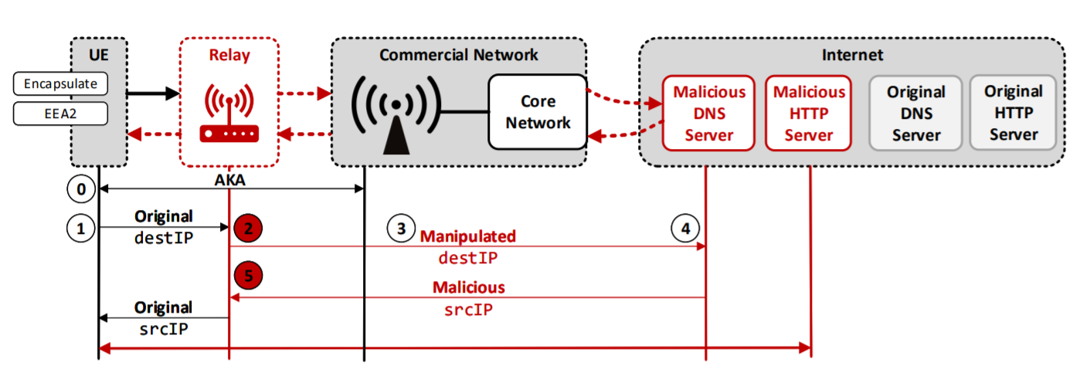
How is it done?
Deploy a malicious relay that will act as UE and eNodeB
AKA is performed between UE and commercial network
UE encapsulates its request in UDP and IP packet and then encrypts it with AES-CTR
Malicious relay intercepts only DNS packet and change the content
Forward the modified packet to the network
Rechange the source IP to the target of the outgoing packet
Notes:
First, they deploy the malicious relay that will act both as UE and eNodeB
Authentication and Key agreement is performed between UE and the commercial network
All requests are encapsulated in UDP and IP packet and then encryption is performed with AES in counter mode
The Malicious relay sitting in the middle will eavesdrop and intercepts only DNS packets and change their actual content (destination ip in this case)
Then, it will forward the modified packet to the network
When the network replies with the dns response, the relay will change the source IP so it matches the original source IP of the original request

Slide 29
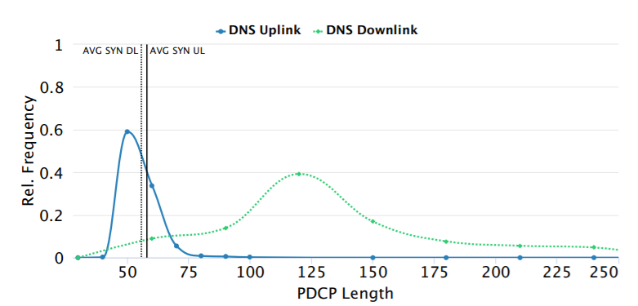
Keys to success
Stable Malicious Relay
Key for the aLTEr attack
Make the user connect to the malicious eNodeB by transmitting at higher frequencies than the commercial network
Set correct configuration parameters (data bearer, RLC, etc)
DNS requests and responses
Only altering DNS requests
Reliable way to distinguish DNS requests from all the traffic (encrypted)
DNS packet length is usually smaller than other TCP packets
Notes:
While the attack procedure is pretty straightforward, there are several things to consider for the attack to be successful and for the attacker to remain undetected during the process.
First is obviously the malicious relay as without it, there is not attack. It will impersonate an eNodeB towards the user and a user towards the eNodeB so it will relay communications between both devices. It will need to make the user connects to the eNodeB by transmitting at higher frequencies than the legit eNodeB
Then it has to set configuration parameters for the data bearer, RLC configuration and physical layer configuration.
Then it needs to distinguish DNS requests from other TCP packets so they won’t change other packets. Therefore they needed to find a reliable way to distinguish them even though they can’t read the payload as it is encrypted. One way was looking at the PDCP length.
(figure) They figured that DNS packet length is usually smaller than other TCP packets but TCP SYN packets are of comparable length. They analysed from the previous traces that they got from the website fingerprinting attack and deduce that in downlink transmissions, DNS and TCP SYN are significantly different as you can see on the graph.

Slide 30
Keys to success
Packet modification
Applying a mask to the original IP and flip bits to match the malicious server’s IP
AES-CTR is malleable => possible to change the ciphertext
Notes:
To modify the packet, the attacker will apply a mask to the original IP so it will flip bits to match the malicious server.
For example, say you have a message equal to 01010101, as we use AES in counter mode, it will generate a keystream based on a counter, for example s equal to 10010110
Using the keystream, it will encrypt the message into the ciphertext c equal to 11000011
Say that the attacker wants to flip the second bit in the plaintext message m by changing c to c’ by applying its mask 0100000
It would give a modified ciphertext 10000011
The decryption would use CTR mode to derive the same key stream s as before, but use it to decrypt c′, which would result in 00010101.
As you can see the second bit of the plaintext message has been flipped just by applying a mask to the ciphertext

Slide 31
Consequence of bit manipulation
Checksum modified
Original payload changed
Packet dropped
How to keep the same checksum after manipulation?
Changing other bits besides the target IP
Notes:
Notably, the checksum will change because the original payload changed. This will result in the packet being dropped
So how to keep the same checksum so the packet won’t be dropped?
(figure)Pretty simple, we change other bits besides the target IP ones.
So we need to change IP and UDP header checksum with another bit manipulation process

Slide 32
IP Header checksum
Downlink
Uplink
Notes:
We don’t want to change routing fields in the IP header, and we need to know the content or can predict it. A good candidate in the uplink transmission is the (figure) TTL field, as modification has minor incidence on routing and the value is easy to determine by performing analysis on the OS for example. TTL is not modified before reaching the first router so the attacker knows its value.
In the downlink direction, we don’t know the exact value of the TTL field, because we don’t know how many hops it traversed before reaching the relay. So, instead of the TTL field, we can manipulate (figure) the Identification field which is used for fragmentation of IP packets. So now the packet remains valid in both uplink and downlink path.

Slide 33
UDP Header checksum
Also affected by packet bit manipulation
Easier to bypass
Set the UDP checksum to 0
Notes:
Just like the IP Header checksum, UDP’s header checksum is also modified
But unlike IP, it is easier to bypass this just by setting (figure) the UDP checksum of the DNS response to 0 and the dns response still remains valid even in cases where the source ip address is modified

Slide 34
Setup
Notes:
This is a setup they used to perform the experiment. They put the phone in a shielding box to make sure that the UE connects to the eNodeB component which is a part of the malicious relay.
eNodeB component, relay implementation and ue component are part of the malicious relay

Slide 35
Experiment

Slide 36
aLTEr attack results
Airplane mode before the experiment
Delete all cache (DNS & HTTP)
Placed inside a shielding box
Real-world applicability?
Notes:
So to perform this experiment successfully, they had to put the phone into airplane mode first to be able to start the radio layer connection and delete all dns and http cache because it may contain previous request to the website.
Then they placed it into a shielding boss presumably to respect ethics guidelines but also because they wanted the UE to connect to their malicious relay
So this setup is not very realistic obviously, having to put the UE in a shielding box, initializing radio layer connection beforehand and deleting cache from the filesystem doesn’t sound very practical

Slide 37
Defenses
Update the specifications: encryption protocol with authentication
Devices must implement such protocol
High financial and organization effort
HSTS: prevents redirection to a malicious website
Site wants to communicate only using SSL/TLS
Notes:
The authors proposed 2 countermeasures
First, updating the specifications to use an encryption protocol with authentication like AES-GCM. However, the researchers believe this is likely not feasible in practice, as the implementation of all devices must be changed to do this, which will lead to a high financial and organizational effort, and most cellular network providers will not bother to do that.
Then, another defense would be forcing all websites to use HSTS, helping prevent redirection of users to a malicious website. it provides the ability to tell the browser that a site only ever wants to use SSL/TLS to communicate

Slide 38
Conclusion
Identity mapping attack
Match TMSI to RNTI
Localize and identify user within a cell
Website fingerprinting attack
Learn transmission characteristics from a user
Distinguish accessed websites
aLTEr attack
Lack of integrity protection
AES-CTR is malleable
DNS spoofing by changing the payload
Notes:
So, what did you learn today?
Attacking only layer 2, an adversary could map the user’s TMSI to the RNTI. From this, he can locate and identify a user within the cell and use this attack as a stepping stone to other attacks.
Then, they performed website fingerprinting. This is already a well known context where traffic analysis allows an attacker, through leak in the resource allocation, to distinguish accessed websites and de-anonymize a connection.
Finally, the last attack which is the alter attack exploited the lack of integrity protection and the fact that AES in counter mode is malleable to perform a dns spoofing attack

Slide 39
Future work
Will this work on 5G?
AT&T and Verizon started implementing 5G
Complicated to update specifications
D. Basin and al., “A Formal Analysis of 5G Authentication”, CCS’18
Analysis of 5G specifications (722 pages across 4 documents)
Identify missing security goals and flaws
Focusing on AKA in 5G
Notes:
Obviously, future work will be focused on 5G.
Since the attacks work by abusing a design flaw of the LTE network, it cannot be patched, as it would require doing changes to LTE protocol.
In response to the attacks, the 3GPP group, which develops standards for the telecommunications industry, said that an update to the 5G specification might be complicated because carriers like Verizon and AT&T have already started implementing the 5G protocol.
So, researchers started analysing 5G technical specification (722 pages across 4 documents) to extract and interpret the security assumptions and goals in order to identify key missing security goals and flaws.
More specifically, they will focus on AKA in 5G which is the Authentication and Key Agreement protocol. They tackle confidentiality, privacy and authentication and might be a great stepping stone for future work about 5G.

Slide 40
Questions

